Slide 1
Heterogeneous Computing with PyOpenCL
University of Southampton
FEEG6003
March 20th 2017
Workshop By: Alex Fforde and Roshan Pasupathy

Slide 2

What is OpenCL ?
Open Computing Language
OpenCL lets programmers write a single program that can use all the resources on a heterogeneous platform
GPUs
Increasingly general purpose data-parallel computing
CPUs
Multiple cores driving performance increases
Emerging Intersection
Graphics APIs and Shading Languages
Multi-processor programming – e.g. OpenMP
Heterogeneous Computing
Image Credit: Simon McIntosh-Smith and Tom Deakin
Notes:
Credit: Simon McIntosh-Smith and Tom Deakin
Source: https://github.com/HandsOnOpenCL/Lecture-Slides/releases

Slide 3
How it came about
Credit: Simon McIntosh-Smith and Tom Deakin
Notes:
Credit: Simon McIntosh-Smith and Tom Deakin
Source: https://github.com/HandsOnOpenCL/Lecture-Slides/releases

Slide 4
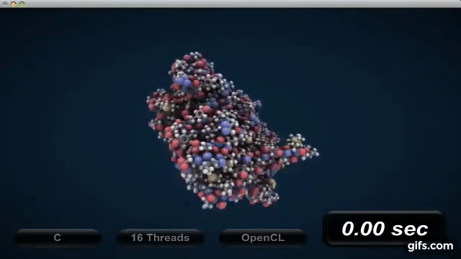
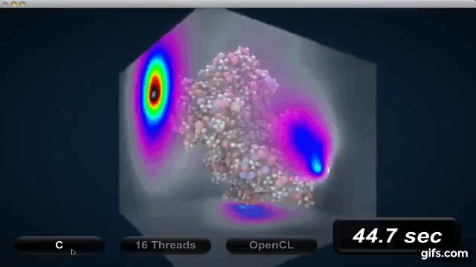
Single-thread C execution (Intel Xeon 2 GHz)
Credit: David Gohara
Notes:
Used with permission from David Gohara
Original video: Demonstration given by David Gohara at WWDC 2011 (Electrostatic modelling of molecules (APBS))
Also available on Youtube: https://www.youtube.com/watch?v=QA483lIvL-4&t=2095s#t=33m10s

Slide 5
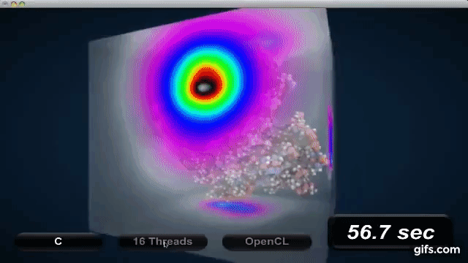
16-thread C execution (Intel Xeon 2 GHz)
Credit: David Gohara
Notes:
Used with permission from David Gohara
Original video: Demonstration given by David Gohara at WWDC 2011 (Electrostatic modelling of molecules (APBS))
Also available on Youtube: https://www.youtube.com/watch?v=QA483lIvL-4&t=2095s#t=33m10s

Slide 6
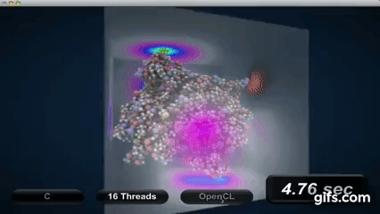
OpenCL (NVIDIA GTX 285)
Credit: David Gohara
Notes:
Used with permission from David Gohara
Original video: Demonstration given by David Gohara at WWDC 2011 (Electrostatic modelling of molecules (APBS))
Also available on Youtube: https://www.youtube.com/watch?v=QA483lIvL-4&t=2095s#t=33m10s

Slide 7
Contents
Runtime
Platform
Devices
Context
Command Queues
Work groups
Work items
Kernels
Memory models
Host-Side
(PyOpenCL)
Device-side
Programming language
~ C - 99

Slide 8
Host Side
Runtime
Platform
Devices
Context
Command Queues
Work groups
Work items
Kernels
Memory models
Host-Side
(PyOpenCL)
Device-side
Programming language
~ C - 99

Slide 9
Host Side: Host
Host side programming can be done in C, C++ or Python (via PyOpenCL)
PyOpenCL: Simplifies creation of all the necessary objects
>>> import pyopencl as cl
>>> import numpy

Slide 10
Host Side: Platforms
Platform: A collection of devices all from the same vendor
All devices on a platform use the same CL Driver
>> platforms = cl.get_platforms()
>> print(platforms)
>> platforms[0].version

Slide 11
Host Side: Compute Devices
Device: Any processor which fits in the OpenCL model
CPUs, GPUs, DSP units ……
>>> devices = platforms[0].get_devices()
>>> print(devices)
…
…
…
…
…
…
…
Processing Element
…
…
Host
…
…
…
…
…
…
Compute Unit
OpenCL Device
Image Credit: Simon McIntosh-Smith and Tom Deakin
Notes:
Credit: Simon McIntosh-Smith and Tom Deakin
Source: https://github.com/HandsOnOpenCL/Lecture-Slides/releases

Slide 12
Host Side: Context
Context: The environment within which kernels execute and in which synchronization and memory management is defined
Multiple contexts for one platform
Multiple devices in one context
>>> context = cl.create_some_context()

Slide 13
Host Side: Command Queues
All commands for a device (kernel execution, synchronization, and memory transfer operations) are submitted through a command-queue.
Each command-queue points to a single device within a context.
>>> queue = cl.CommandQueue(context)
Image Credit: Andreas Klöckner
Notes:
Credit: Andreas Klöckner
Source: https://www.bu.edu/pasi/files/2011/01/AndreasKloeckner1-03-1430.pdf

Slide 14
Host Side Summary: As a Card Game
Host: Card Dealer
Device: Individual Player
Platform: Collection of players
Command Queues: A player’s hand
Context: Card table
Program: The Deck of Cards
Kernel: An individual Card
Example and Image Credit: Matthew Scarpino
Notes:
Credit: Matthew Scarpino
Article: http://www.drdobbs.com/parallel/a-gentle-introduction-to-opencl/231002854

Slide 15
Device Side
Runtime
Platform
Devices
Context
Command Queues
Work groups
Work items
Kernels
Memory models
Host-Side
(PyOpenCL)
Device-side
Programming language
~ C - 99

Slide 16
Device Side: Work Items and Work Groups
In order to write OpenCL source files, we model our compute devices as a collection of work items arranged into work groups.
These work items execute the same kernel function as instructed by the host.
Image Credit: Olmo Zavala
Notes:
Used for educational purposes
Credit: Olmo Zavala
Source : http://olmozavala.com/index.php/code/openclcode

Slide 17
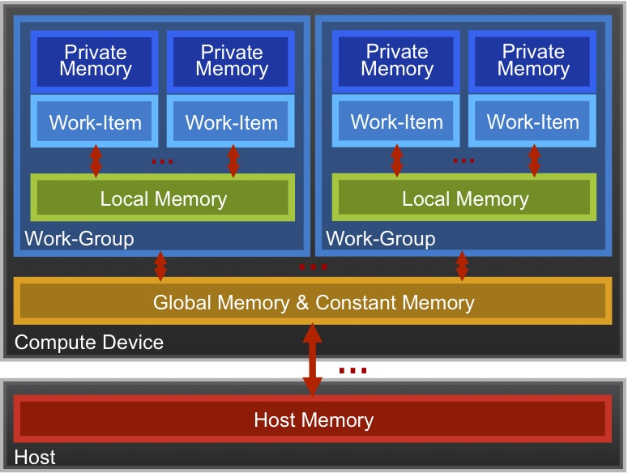
Device Side: Memory Model
Memory management in OpenCL is explicit.
Managing the memory hierarchy is one of the most important things to get right to achieve good performance
GPUs use on-chip caches for local memory
CPUs usually do not have specific hardware for local memory
Image Credit: Simon McIntosh-Smith and Tom Deakin
Notes:
Credit: Simon McIntosh-Smith and Tom Deakin
Source: https://github.com/HandsOnOpenCL/Lecture-Slides/releases

Slide 18
Device Side: Kernel Execution
OpenCL is used to solve problems which have dimensionality – array, list, matrix, image operations.
Consider multiplying each element of an array by 2
__kernel void times_two(
__global float* input,
__global float* output)
{
int i = get_global_id(0);
output[i] = 2.0f * input[i];
}
get_global_id(0)
10
Input
0 | 1 | 2 | 3 | 4 | 5 | 6 | 7 | 8 | 9 | 10 | 11 | 12 | 13 | 14 | 15 | 16 | 17 | 18 | 19 | 20 | 21 | 22 | 23 | 24 | 25
Output
0 | 2 | 4 | 6 | 8 | 10 | 12 | 14 | 16 | 18 | 20 | 22 | 24 | 26 | 28 | 30 | 32 | 34 | 36 | 38 | 40 | 42 | 44 | 46 | 48 | 50
Image Credit: Simon McIntosh-Smith and Tom Deakin
Notes:
Credit: Simon McIntosh-Smith and Tom Deakin
Source: https://github.com/HandsOnOpenCL/Lecture-Slides/releases

Slide 19
How do these models map onto hardware ?
Work items from their respective groups are mapped onto processing elements of the compute devices.
The mapping of the model onto the hardware is performed by the runtime when we call the .build() attribute.
Device Cores executing Work groups
Image Credit: Texas Instruments
Notes:
Used for educational purposes
Credit: Texas Instruments
Article: Understanding Kernels, Work-groups and Work-items
Link: http://downloads.ti.com/mctools/esd/docs/opencl/execution/kernels-workgroups-workitems.html#understanding-kernels-work-groups-and-work-items

Slide 20
Lets try a few exercises
Modify the source file ‘vector_add.cl’ and execute vector_add.py

Slide 21
2. Modify the source file ‘matrix_mult.cl’ and run matrix_mult.py
C code:
Hint: The number of rows and columns in C are assigned as work_items_size(0) and work_items_size(1) respectively
Code and image Credit: Simon McIntosh-Smith and Tom Deakin
Notes:
Credit: Simon McIntosh-Smith and Tom Deakin
Source: https://github.com/HandsOnOpenCL/Lecture-Slides/releases

Slide 22
3. Modify the source file ‘vector_iteradd.cl’ and execute vector_iteradd.py
Instructions:
In exercise 1, you had N work items to evaluate N elements.
Now you have only N/ITER work items to evaluate the same N elements. (N = 1024, ITER = 16).
Hint: Each work item evaluates 16 elements

Slide 23
Building and Executing using PyOpenCL
Read source file ‘vector_add.cl’
>>> source = open(‘vector_add.cl’).read()
Build Source file
>>> program = cl.Program(context, source).build()
Source files are built at runtime because the compiled code is largely dependent on the device

Slide 24
Setup Memory Objects
For vector_add.cl we need three memory objects
# create host arrays
h_a = numpy.random.rand(N).astype(float32)
h_b = numpy.random.rand(N).astype(float32)
h_c = numpy.empty(N).astype(float32)
# create device buffers.
mf = cl.mem_flags #flags for type of memory
d_a = cl.Buffer(context, mf.READ_ONLY | mf.COPY_HOST_PTR, hostbuf=h_a)
d_b = cl.Buffer(context, mf.READ_ONLY | mf.COPY_HOST_PTR, hostbuf=h_b)
d_c = cl.Buffer(context, mf.WRITE_ONLY, h_c.nbytes)
Notes:
-

Slide 25
Set Kernel Arguments
The vector_add function is a module in the dynamic library vector_add
>>> vector_add = program.vector_add
We now need to pass arguments to the vector_add function
For this we first need to define scalar argument types
>>> vector_add.set_scalar_arg_dtypes([None, None, None, numpy.uint32])
# Use ‘None’ for vector arguments (Defined by cl.Buffer)
# Use ‘numpy.uint32’ for unsigned integer argument N

Slide 26
Set Kernel Arguments and Run
On the host side additonal parameters have to be passed to a kernel function:
Queue (queue)
Work_item_size: A tuple consisting of the total number of work items in each dimension (h_a.shape)
Work_items_per_group: A tuple consisting of the total number of work iterms per group in each dimension. ‘None’ means all work items in 1 group.
>>> vector_add(queue, h_a.shape, None, d_a, d_b, d_c, N)
Read output from device buffer d_c to host buffer h_c
>>> cl.enqueue_copy(queue, h_c, d_c)

Slide 27
Exercise 4: Complete ’exercise4.py’ and run
Instructions:
Create device buffers where necessary
Set globalrange
Set localrange
Set arg_type_list for the kernel function

Slide 28
Synchronisation
Results of an algorithm should be independent of order of execution of work groups
Credit: Andreas Klöckner
Notes:
Credit: Andreas Klöckner
Source: https://www.bu.edu/pasi/files/2011/01/AndreasKloeckner1-03-1430.pdf

Slide 29
How do we ensure this ?
Host-Device: Using command queue events which indicate whether a function has been completed or not.
>>> event = cl.enqueue_read_buffer(queue, d_c, h_c)
>>> event.wait()
Intra group synchronisation
Barriers: barrier.()
Fences: mem_fence.()

Slide 30
Barriers
Work items do not proceed ahead of barrier until all other work items in the same group have reached the barrier
WI 1
WI 2
WI 3
WI 2
WI 2
WI 1
WI 3
WI 1
WI 3
Image Credit: Andreas Klöckner
Notes:
Credit: Andreas Klöckner
Source: https://www.bu.edu/pasi/files/2011/01/AndreasKloeckner1-03-1430.pdf

Slide 31
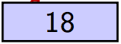
Fences
Waits until all read and writes made by the calling work item prior to memory fence are visible to all threads in the work group
The memory fence can be placed on global or/and local memory using: CLK_LOCAL_MEM_FENCE, CLK_GLOBAL_MEM_FENCE
Write 18:
successful
Read
Write 18:
unsuccessful
17

Slide 32
Installation
All Mac OSX (> 10.6) and Windows 10 have a preinstalled OpenCL implementation
Instructions to install OpenCL on Linux Distributions will be made available shortly on the online repository
PyOpenCL packages with instructions available at Andreas Klöckner's wiki.

Slide 33
Install OpenCL Ubuntu (>12.04)
Install the ICD loader and header files
$ sudo apt-get install ocl-icd-opencl-dev
Download and install SDKs which includes runtimes for the devices you want to run
Intel : Only CPU and Intel integrated graphics (Download Page)
AMD: Support for CPUs and AMD devices (Download Page)
NVIDIA: Support for Nvidia GPUs (Download Page)
Notes:
Intel Link:
https://software.intel.com/en-us/intel-opencl?cid=sem43700008896000156&intel_term=intel+openCL&gclid=Cj0KEQjw-73GBRCC7KODl9zToJMBEiQAj1Jgf7L4fsTW4byViAOn3p4rCGHXbjRDDEMf4r9B5Xz8aCAaAm9E8P8HAQ&gclsrc=aw.ds
AMD page:
http://developer.amd.com/tools-and-sdks/opencl-zone/amd-accelerated-parallel-processing-app-sdk/
Nvidia page:
https://developer.nvidia.com/opencl

Slide 34
Build PyOpenCL on Apple and Linux
Libraries needed: numpy and cffi
$python configure.py
$make
$sudo make install

Slide 35
Build PyOpenCL on Windows 10
Install the latest 64 bit Anaconda distribution with Python 3.x on it
Find a pyopencl prebuilt binary.
Download pyopencl-2016.2.1+cl21-cp36-cp36m-win_amd64.whl to a folder of choosing
Open terminal and navigate to that folder
>> pip install pyopencl-2016.2.1+cl21-cp36-cp36m-win_amd64.whl
Download demo.py from repository to the same folder
>> python demo.py #testing step
Credit: IBM
Notes:
Credit: IBM
https://www.ibm.com/developerworks/community/blogs/jfp/entry/Installing_PyOpenCl_On_Anaconda_For_Windows?lang=en
Prebuilt binaries link:
http://www.lfd.uci.edu/~gohlke/pythonlibs/?cm_mc_uid=85337168801614888902284&cm_mc_sid_50200000=1489954410#pyopencl
Demo.py repo:
https://github.com/pyopencl/pyopencl/tree/master/examples

Slide 36
Thank You

